Slide 1
Agentic QA Platform
Collaborator_BLR

Slide 2

Agentic QA Platform for Email Campaigns
BUSINESS CHALLENGE
This challenge focuses on developing an intelligent, agentic Quality Assurance (QA) platform designed to automate the multi-modal testing of promotional email content. The goal is to significantly reduces the manual effort involved in QA, allowing human experts to focus on more strategic aspects of campaign development.
Impact
SOLUTION
Reduce manual effort by 60–80%.
Agentic QA Platform
The platform:
Ingests Email Proof, Checklist, CWS, Global Matrix, Copy Doc/PDF
Determines campaign type (Newsletter or Non-Newsletter)
Extracts modules, subject, preheader, body, CTAs, footer
Performs rule-based + LLM-based validation
Compares Email Proof with approved source of truth
Generates PASS/FAIL Summary and Detailed QA Report
Ensures consistency, accuracy, and compliance

Slide 3


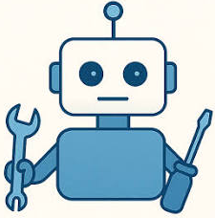




Technical Architecture
Fine-tune Agent for better accuracy
LLM – gpt-4o
Reasoning, tone & grammar checks Deviation detection, JSON assembly
Human Feedback
Pre-Processing Functions
• Extract text, images from html • Read word document • Read logo from excel
QA Analyst Agent
CrewAI agent: Interprets inputs, calls tools, Builds structured JSON QA report
Brand image matching
Using mapping URL
Enhanced QA Report
JSON to structured object Tone, grammar, deviations, similarity, logo validation, score
User
APP UI
File upload:
(HTML, DOCX, XLSX) & brand guidelines form
Compute Similarity Tool
TF-IDF cosine similarity Email body vs. reference copy

Slide 4
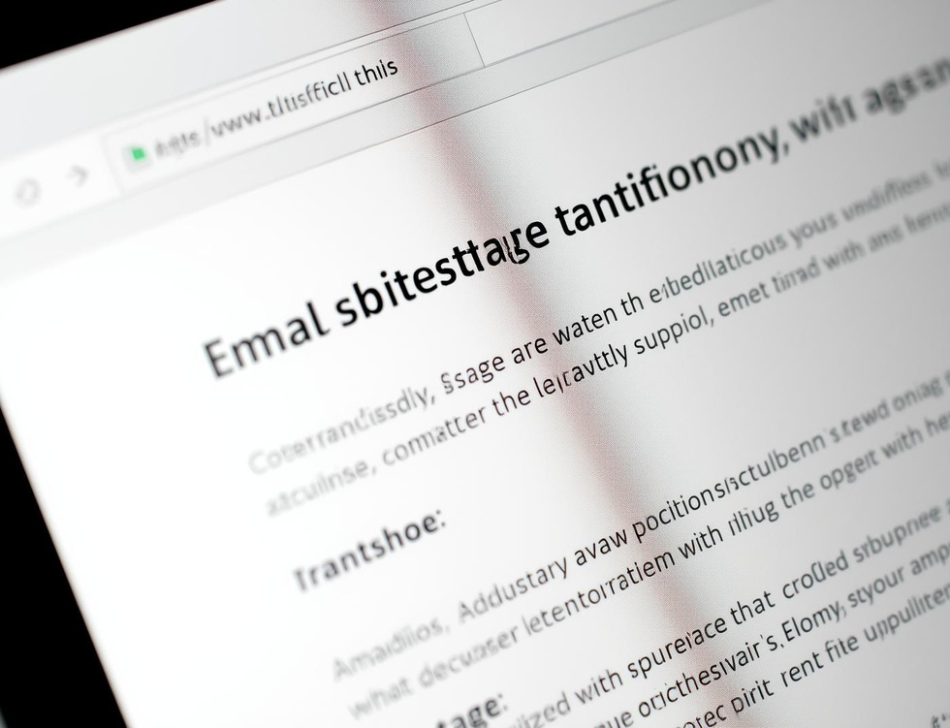


Multi-Modal QA Agents
Copy QA
Visual QA
Structural QA
Evaluates semantic alignment against original copy to ensure consistency and accuracy.
Verifies logos, imagery, and creative components for quality and brand consistency.
Checks URLs, HTML structure, and compliance to ensure all elements are correct.

Slide 5
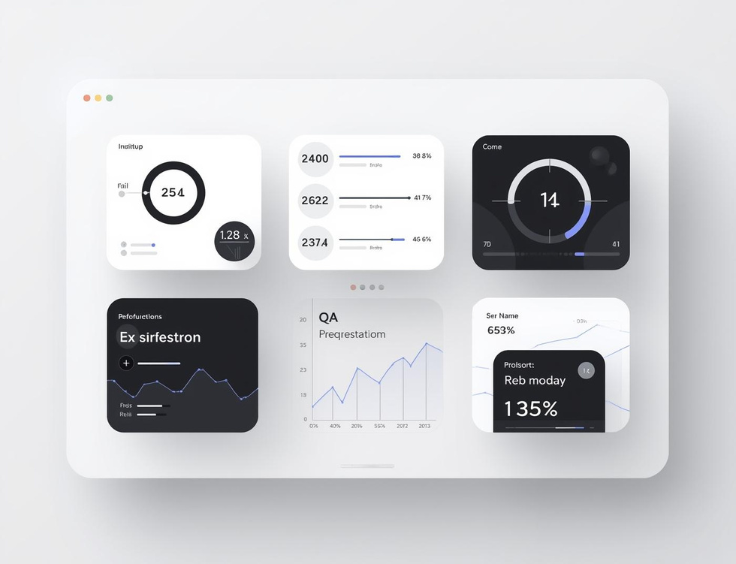
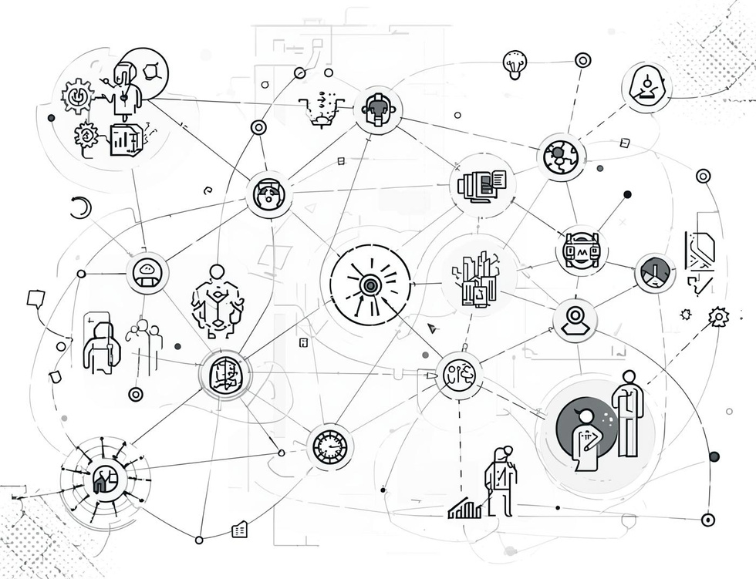

One-Click QA
Seamless Integration
Automated Evaluation
Instant Reporting
Users initiate the QA process by simply clicking the 'Run QA with a button'.
Agents swiftly evaluate email content against pre-defined reference assets for accurate results.
Reports generated include clear PASS/FAIL indicators along with concise reasoning for outcomes.

Slide 6

Roadmap and Extension
Expanding the Campaign QA Copilot
Integration with Major ESPs
Auto Fix
Deeper visual QA capabilities & Enhanced accessibility compliance checks
ESP integrations (SFMC, Braze, Mailchimp) for automated proof retrieval
AI-powered auto-fix suggestions for copy & HTML & Comprehensive organizational analytics

Slide 7

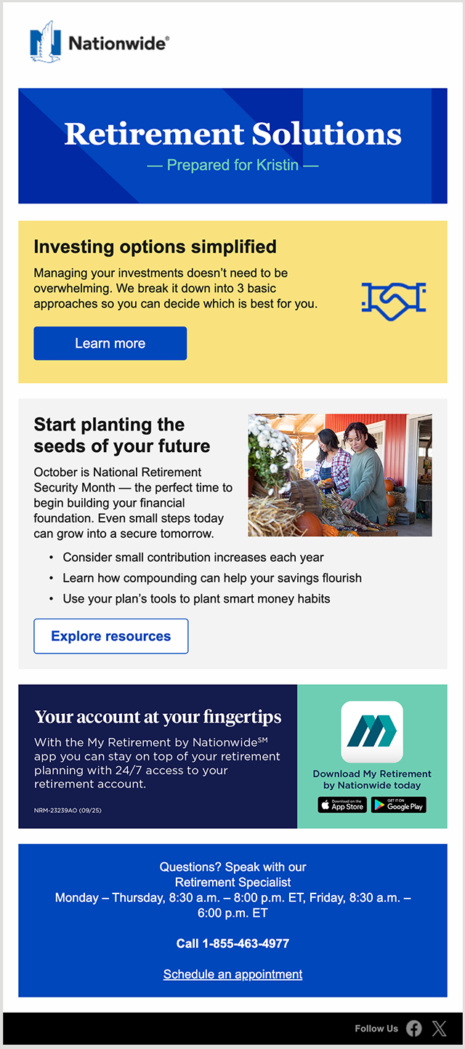
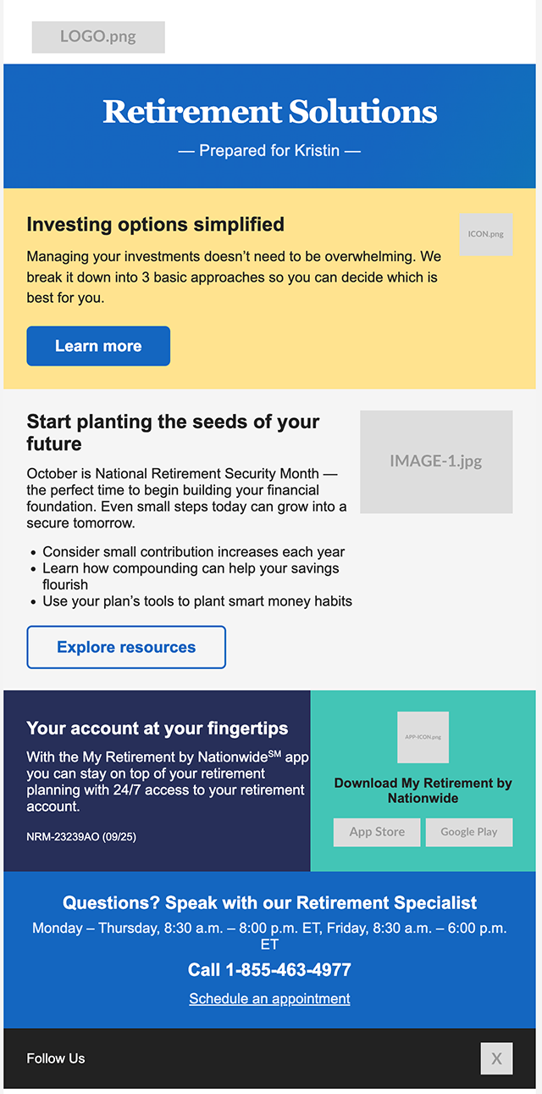
Bonus Feature
From Screenshot to Send-Ready HTML Automatically

Slide 8
Thank you!

